Slide 1
Compiler Construction(CMPCC)

Slide 2
Assembly language statements
Imperative statements
Indicate an action to be performed during the execution.
Declarative statements
[label] DS <constant>
[label] DC <value>
A DS 1
B DS 200
ONE DC ‘1’
Assembler directives
START <constant>
END [<operand spec >]
Notes:
<number>

Slide 3
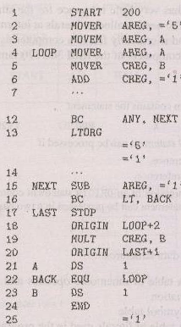
An Assembly Language Program
Notes:
<number>

Slide 4
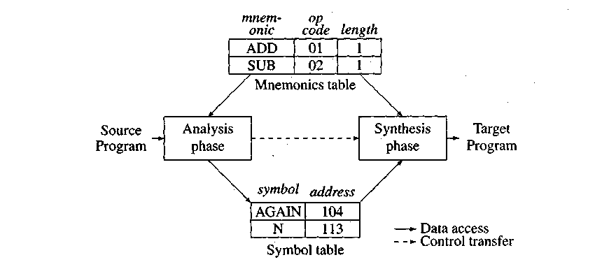
Data structures of the assembler
Notes:
<number>

Slide 5
Data structures for two pass assembler
Mnemonic opcode table
Symbol table
Literal table
Pool table
Notes:
<number>

Slide 6
Declarative Statements
Define Constant(DC) :The define constant assembler directive allows you to put a data value in memory at the time that the program is first loaded
Define Storage(DS) : The define storage directive is used to reserve one or more memory locations

Slide 7
Advanced Assembler Directives
ORIGIN
EQU
LTORG
Notes:
<number>

Slide 8
LTORG :Use the LTORG instruction so that the assembler can collect and assemble literals into a literal pool
Equate: The EQU assembler directive simply equates a symbolic name to a numeric value. Consider: Sunday EQU 1
Monday EQU 2
You could also write Sunday EQU 1
Monday EQU Sunday + 1
In this case, the assembler evaluates "Sunday + 1" as 1 + 1 and assigns the value 2 to the symbolic name "Monday

Slide 9
Origin : The origin directive tells the assembler where to load instructions and data into memory
ORG 1024

Slide 10
Mnemonic operation code (Mnemonic opcode)
Instruction Opcode | Mnemonic
00 | STOP
01 | ADD
02 | SUB
03 | MULT
04 | MOVER
05 | MOVEM
06 | COMP
07 | BC
08 | DIV
09 | READ
10 | PRINT
Notes:
<number>

Slide 11
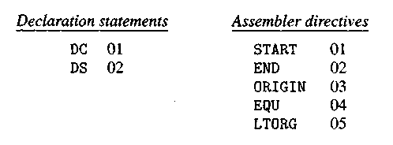
Code for declaration statements and directives
Notes:
<number>

Slide 12
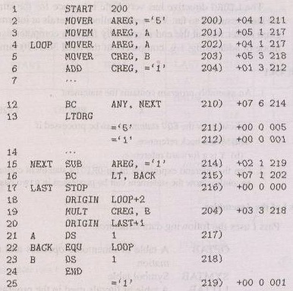
An assembly program
Notes:
<number>

Slide 13
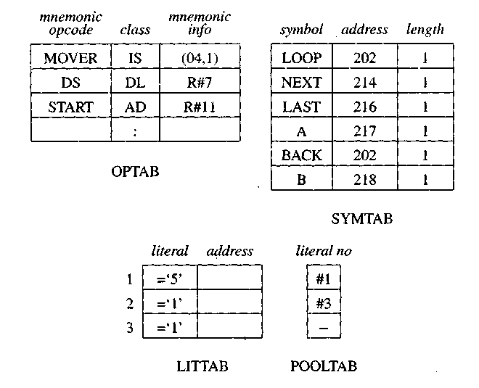
Data structures of assembler pass I
Notes:
<number>

Slide 14
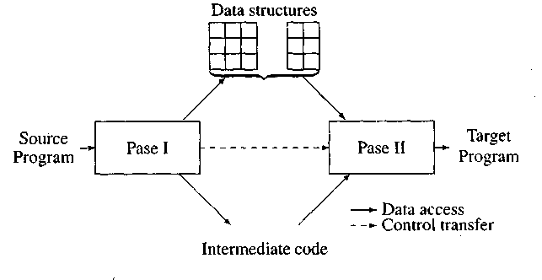
Overview of two pass assembler
Notes:
<number>

Slide 15
Tasks of two pass assembler
Pass 1
Separate the symbol, mnemonic opcode & operand fields.
Build the symbol table
Perform LC processing
Construct intermediate representation.
Pass 2
Synthesize the target program.
Notes:
<number>

Slide 16
An Intermediate code unit
Address | Opcode | Operands
Notes:
<number>

Slide 17
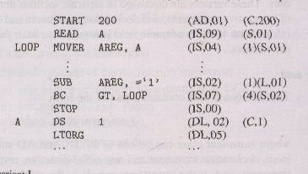
Intermediate code – variant I
Notes:
<number>

Slide 18
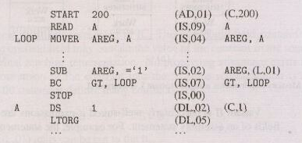
Intermediate code – variant II
Notes:
<number>

Slide 19
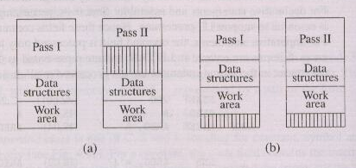
Memory requirements using variant I and variant II
Notes:
<number>

Slide 20
Assignment 1
Generate Symbol table, literal table & Intermediate code of a two-pass Assembler for the given source code.
INPUT
START 200
MOVER AREG X 200
ADD AREG =’3’ 201
MOVEM AREG Y 202
X DC 1 203
Y DS 1 204
END 205

Slide 21
START: This instruction starts the execution of program from location 200.
MOVER: It moves the content of symbol into register AREG.
ADD: It adds the contents of X(which is stored in AREG )with Y.
MOVEM: It moves the content of register into memory operand Y.
DS (Data Storage): It assigns a data space of 1 to Symbol X.
DC (Define Constant) :It allows you to put a data value in memory at the time that the program is first loaded
END: It finishes the program execution
INPUT
1START 200
2 MOVER AREG X 200
3 ADD AREG =’3’ 201
4 MOVEM AREG Y 202
5 X DC 1 203
6 Y DS 1 204
7 END 205

Slide 22
Symbol Table
Literal Table
Step 1: START 200 (here no symbol or literal is found
so both table would be empty)
Step 2: MOVER AREG X 200
(here X is symbol so symbol table is made)
X is a symbol referred prior to its declaration so it is stored in symbol table with blank address field.
INPUT
1 START 200
2 MOVER AREG X 200
3 ADD AREG =’3’ 201
4 MOVEM AREG Y 202
5 X DC 1 203
6 Y DS 1 204
7 END 205
Symbol | Address
Literal | Address
Symbol | Address
X

Slide 23
Step 3: ADD AREG =’3’ 201
(here =’3’ is literal so literal table is made)
Step 4: MOVEM AREG Y 202
Y is a symbol referred prior to its declaration so it is stored in symbol table with blank address field.
Literal | Address
=’3’
INPUT
1 START 200
2 MOVER AREG X 200
3 ADD AREG =’3’ 201
4 MOVEM AREG Y 202
5 X DC 1 203
6 Y DS 1 204
7 END 205
Symbol | Address
X
Y

Slide 24
Step 5: X DC 1 203
It is a data declaration statement i.e X is assigned value of 1.
But X is a symbol which was referred earlier in step 2 and defined in step 5
This condition is called Forward Reference Problem where variable is referred prior to its declaration
This can be solved by back-patching
So now assembler will assign X the address specified by LC value of current step
INPUT
1 START 200
2 MOVER AREG X 200
3 ADD AREG =’3’ 201
4 MOVEM AREG Y 202
5 X DC 1 203
6 Y DS 1 204
7 END 205
Symbol | Address
X | 203
Y

Slide 25
Step 6: Y DS 1 204
It is a data declaration statement i.e Y is assigned data space of 1
Y is a symbol which was referred earlier in step 4 and defined in step 6
This condition is called Forward Reference Problem where variable is referred prior to its declaration
This can be solved by back-patching
So now assembler will assign Y the address specified by LC value of current step
INPUT
1 START 200
2 MOVER AREG X 200
3 ADD AREG =’3’ 201
4 MOVEM AREG Y 202
5 X DC 1 203
6 Y DS 1 204
7 END 205
Symbol | Address
X | 203
Y | 204

Slide 26
Step 7: END 205
Program finishes execution and literal will get address specified by LC value of END instruction
Here is the complete symbol and literal table made by pass 1 of assembler
INPUT
1 START 200
2 MOVER AREG X 200
3 ADD AREG =’3’ 201
4 MOVEM AREG Y 202
5 X DC 1 203
6 Y DS 1 204
7 END 205
Symbol | Address
X | 203
Y | 204
Literal | Address
=’3’ | 205

Slide 27
Input Intermediate Code
START 200 (AD,01) (C,200)
MOVER AREG X 200 (IS, 01) AREG X
ADD AREG =’3’ 201 (IS, 02) AREG (L,01)
MOVEM AREG Y 202 (IS, 03) AREG Y
X DC 1 203 (DL, 01) (C,01)
Y DS 1 204 (DL, 02) (C,01)
END 205 (AD, 02)

Slide 28
Sample Example
START 200
LOAD MOVER AREG, A ----------------200
MOVER BREG, =‘2’ --------------------201
ADD AREG, =‘2’-----------------------202
SUB BREG, =‘3’ -------------------------203
LTORG ------------------------------------204 (Add of =‘2’)
-------------------------------------------205 (Add of =‘3’)
MOVER AREG, =‘4’------------------------206
ADD BREG, =‘2’-------------------------207
A DC 5----------------------------------------------208
END-----------------------------------------------209 (Add of =‘4)
----------------------------------------------210(add of =‘2)

Slide 29
Symbol Table
Symbol Name | Address
Load | 200
A | 208
Literal Table
Literal Name | Address
‘=2’ | 204
‘=3’ | 205
‘=4’ | 209
‘=2’ | 210
Pool Table
#1
#3

Slide 30
Sample Example
START 200 LC
MOVER AREG,=‘7’ 200
MOVER BREG,X 201
L1 MOVER BREG, =‘1’ 202
ORIGIN L1+3 203
LTORG 205 add of ‘=7’
206 add of ‘=1’
NEXT ADD AREG, =‘2’ 207
X DS 1 208
END 209 add of ‘=2’

Slide 31
Literal | Address
‘=7’ | 205
‘=1’ | 206
‘=2’ | 209
Pool table
#1
#3
Symbol | Address
X | 208
L1 | 202
Next | 207

Slide 32
Sample Example
START 200 LC
MOVER AREG,=‘7’ 200
MOVER BREG,X 201
L1 MOVER BREG, =‘1’ 202
ORIGIN L1+3 203
LTORG 205……ADD OF =‘7’
206……ADD OF =‘1’
NEXT ADD AREG, =‘2’ 207
X DS 1 208
END 209…..ADD OF =‘2’

Slide 33
Sample Example
INPUT
START 500
MOVER AREG X 500
ADD AREG =’3’ 501
MOVEM AREG Y 502
X DS 4 503 add of x
Y DC 2 507 add of y
END 508 add of ‘=3’

Slide 34
Symbol | Address
X | 503
Y | 507
Literal | Address
‘=3’ | 508
Pool Table
#1

Slide 35
Sample Example
START 500 LC
MOVER BREG, =‘6’ 500
ADD BREG, X 501
LOOP MOVER AREG, =‘2’ 502
ORIGIN LOOP+4 503
N1 ADD AREG, =‘4’ 506
SUB BREG, =‘3’ 507
LTORG 508 Add of ‘=6’
509 Add of ‘=2’
510 Add of ‘=4’
511 Add of ‘=3’
NEXT EQU LOOP 512
MULT AREG, =‘3’ 513
STOP 514
X DS 1 515
END 516

Slide 36
Symbol
X
 | Address
 | 515
LOOP | 502
N1 | 506
NEXT | 502
Literal |  | Address
‘=6’ |  | 508
‘=2’ |  | 509
‘=4’ |  | 510
‘=3’ |  | 511
‘=3’ |  | 516
Pool table
#1
#5

Slide 37
Algorithm : First pass of two pass assembler -1
1. loc-cntr := 0; (default value)
pooltab-ptr := 1;
POOLTAB [1]:=1;
littab-ptr := 1;
2. While next statement is not an END statement
(a) If label is present then
this-label := symbol in label field;
Enter (this-label, loc-cntr) in SYMTAB.
Notes:
<number>

Slide 38
Algorithm : First pass of two pass assembler -2
(b) If an LTORG statement then
(i) Process literals LITTAB [POOLTAB [pooltab-ptr]]... LITTAB [lit- tab-ptr – 1] to allocate memory and put the address in the address field. Update loc-cntr accordingly.
(ii) pooltab-ptr := pooltab-ptr + 1;
(iii) POOLTAB [pooltab-ptr] := littab-ptr;
(c) If a START or ORIGIN statement then
loc-cntr := value specified in operand field;

Slide 39
Algorithm : First pass of two pass assembler - 3
(d) If an EQU statement then
(i) this-addr := value of <address spec>;
(ii) Correct the symtab entry for this-label to (this-label, this-addr).
(e) If a declaration statement then
(i) code := code of the declaration statement;
(ii) size := size of memory area required by DC/DS.
(iii) loc-cntr := loc-cntr + size;
(iv) Generate 1C '(DL, code) …..'.

Slide 40
Algorithm : First pass of two pass assembler - 4
(f) If an imperative statement then
(i) code := machine opcode from OPTAB;
(ii) loc-cntr := loc-cntr + instruction length from OPTAB;
(iii) If operand is a literal then
this-literal := literal in operand field;
LITTAB [littab-ptr] := this-literal;
littab-ptr := littab-ptr + 1;
else (i.e. operand is a symbol)
this-entry := SYMTAB entry number of operand;
Generate 1C '(IS, code)(S, this-entry)’;

Slide 41
Algorithm : First pass of two pass assembler - 5
3. (Processing of END statement)
(a) Perform step 2(b).
(b) Generate 1C '(AD.02)'.
(c) Go to Pass II.

Slide 42
Input Intermediate Code
START 200 (AD,01) (C,200)
MOVER AREG X 200 (IS, 01) AREG X
ADD AREG =’3’ 201 (IS, 02) AREG (L,01)
MOVEM AREG Y 202 (IS, 03) AREG Y
X DC 1 203 (DL, 01) (C,01)
Y DS 1 204 (DL, 02) (C,01)
END 205 (AD, 02)
(AD,01) (C,200) ----- Machine Code
200 (IS, 01) AREG X 200 01 01 203
201 (IS, 02) AREG (L,01) 201 02 01 205
202 (IS, 03) AREG Y 202 03 01 204
203 (DL, 01) (C,01) 203 00 00 001
204 (DL, 02) (C,01) 204 00 00 000
205 (AD, 02) 205 00 00 003

Slide 43
START 200 (AD,01) (C, 200) M/c code------
LOAD MOVER AREG, A 200 (IS, 02) AREG A 200 02 01 208
MOVER BREG, =‘2’ ---201 (IS,02) BREG (L,01) 201 02 02 204
ADD AREG, =‘2’----202 (IS,03), AREG, (L,01) 202 03 01 204
SUB BREG, =‘3’ -----203 (IS,04) BREG (L,02) 203 04 02 205
LTORG ------------------204 (AD,03) 204 00 00 002
-----------------------205 205 00 00 003
MOVER AREG, =‘4’-----206 (IS,02) AREG,(L,03) 206 02 01 209 206
ADD BREG, =‘2’----207 (IS, 03) BREG, (L,04) 207 03 02 210
A DC 5------------------------208 (DL,01) (C,05) 208 00 00 005
END-------------------------209 (AD,02) 209 00 00 004
-----------------------10 210 00 00 002

Slide 44
Algorithm : Second pass of two pass assembler - 1
1. code-area-address := address of code-area;
pooltab-ptr := 1;
loc-cntr := 0;
2. While next statement is not an END statement
(a) Clear machine-code-buffer;
Notes:
<number>

Slide 45
Algorithm : Second pass of two pass assembler - 2
(b) If an LTORG statement
(i) Process literals in LITTAB[POOLTAB[pooltab-ptr]} ... LITTAB [POOLTAB [pooltab-ptr+l] ]—1 similar to processing of constants in a DC statement, i.e. assemble the literals in machine.code, buffer.
(ii) size := size of memory area required for literals;
(iii) pooltab-ptr := pooltab-ptr + 1;

Slide 46
Algorithm : Second pass of two pass assembler - 3
(c) If a START or ORIGIN statement then
(i) loc-cntr := value specified in operand field;
(ii) size := 0;
(d) If a declaration statement
(i) If a DC statement then
Assemble the constant in machine-code-buffer.
(ii) size := size of memory area required by DC/DS;

Slide 47
Algorithm : Second pass of two pass assembler - 4
(e) If an imperative statement
(i) Get operand address from SYMTAB or LITTAB.
(ii) Assemble instruction in machine-code-buffer.
(iii) size '.- size of instruction;
(f) If size != 0 then
(i) Move contents of machine-code-buffer to the address code-area-address + loc-cntr;
(ii) loc-cntr := loc-cntr + size;

Slide 48
Algorithm : Second pass of two pass assembler - 5
3. (Processing of END statement)
(a) Perform steps 2(b) and 2(f).
(b) Write code-area into output file

Slide 49
State TRUE/FALSE
Literal are processed in PASS II
Undefined symbols are detected in Pass-I
Incorrect opcodes are detected in pass-I
Output of an assembler is an object program

Slide 50
QUIZ
In a two pass assembler, adding literals to literal table and address resolution of local symbols
are done using ?
a.First pass and second respectively
b.Both second pass
c.Second pass and first respectively
d.Both first pass

Slide 51
In a two pass assembler the pseudo code EQU is to be evaluated during ?
a. Pass 1
b.Pass 2
c.not evaluated by the assembler
d.None of above

Slide 52
An assembler is
A. programming language dependent
b. syntax dependant
c. machine dependant
d. data dependant

Slide 53
An imperative statement
A. Reserves areas of memory and associates names with them
b. Indicates an action to be performed during execution of assembled program
c. Indicates an action to be performed during optimization
d. None of the above

Slide 54
In a two-pass assembler, the task of the Pass II is to
a. separate the symbol, mnemonic opcode and operand fields.
b. build the symbol table.
c. construct intermediate code.
d. synthesize the target program.

Slide 55
Assembler is a machine dependent, because of?
a. Macro definition table(MDT)
b. Pseudo operation table(POT)
c. Argument list array(ALA)
d. Mnemonics operation table(MOT

